Slide 1
Computer Organization and Architecture-23CSE213
Department of Computer Science & Engineering
Amrita School of Computing, Bengaluru
Amrita Vishwa Vidyapeetham, India

Slide 2
Course Objectives
This course aims to make students, understand, analyse, and appreciate the basic principles, design choices, and trade-offs associated in the field of Computer Architecture.
It describes overview of ARM architecture in terms of instruction set, data path and pipelining
It introduces pipelining and memory systems in detail along with performance metrics for designing computer systems and what can be done to make it better and faster.

Slide 3
Course Objectives
CO | Course Outcomes
CO1 | Understand the design principles of Instruction Set Architecture (ISA) by taking ARM as reference.
CO2 | Understand the design of data and control path in Single Clock Cycle.
CO3 | Understand the design of instruction execution using Multiple Clock Cycles and Analyze / Evaluate the performance of processors.
CO4 | Understand Pipelined architecture and Design of multi-stage pipeline processor in ARM.
CO5 | Apply the working principles of ALU, Memory and I/O in the design of processor.

Slide 4
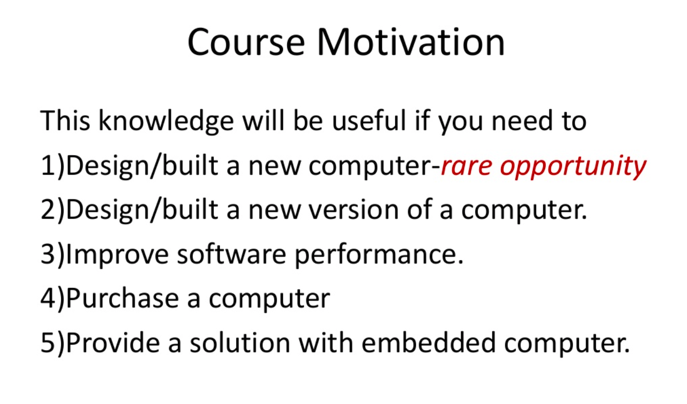

Slide 5
Outline of the course
This course aims at introducing the concept of computer architecture and organization.
It involves design aspects, and deals with the current
trends in computing architecture.
System resources such as memory technology and I/O subsystems needed to achieve proportional increase in performance will also be discussed.

Slide 6
Syllabus Outline
– Introduction of Computing system
– Processor Architecture with example as ARM & Instruction Set
– Single Cycle Datapath Design
– Introduction to multicycle datapath
– Performance of Computing system, Role of performance
– Pipelining Technique
• Design Issues
• Hazards: Structural Hazards, Data Hazards and Control Hazards (Static Branch Prediction, Dynamic Branch Prediction)
– Memory Organization
• Introduction, Cache Memory Organization
– Computer Arithmetic
• Binary multiplication and Division
• Floating Point Arithmetic

Slide 7
Evaluation Pattern
Evaluation Pattern: 50:50
Assessment | Internal | External
Mid Term | 20
Continuous Assessment | 30
End Semester |  | 50

Slide 9
The Computer Revolution
Progress in computer technology
Underpinned by Moore’s Law
Makes novel applications feasible
Computers in automobiles
Cell phones
Human genome project
World Wide Web
Search Engines
Computers are pervasive
Moore’s Law: the no. of transistors per chip doubles every two years

Slide 10
Classes of Computers
Personal computers
General purpose, variety of software
Subject to cost/performance tradeoff
Server computers
Network based
High capacity, performance, reliability
Range from small servers to building sized

Slide 11
Classes of Computers
Supercomputers
High-end scientific and engineering calculations
Highest capability but represent a small fraction of the overall computer market
Embedded computers
Hidden as components of systems
Stringent power/performance/cost constraints

Slide 12
The PostPC Era

Slide 13
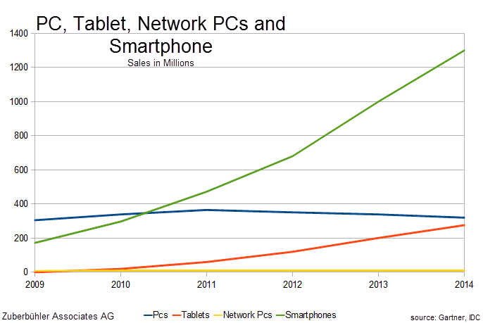

Slide 14
The Post PC Era
Personal Mobile Device (PMD)
Battery operated
Connects to the Internet (wireless)
Hundreds of dollars
Smart phones, tablets, electronic glasses
Cloud computing
Warehouse Scale Computers (WSC)
Software as a Service (SaaS) (web search, social networking)
Portion of software run on a PMD and a portion run in the Cloud
Amazon and Google

Slide 15
Cloud Computing
Cloud computing refers to
large collection of servers that provide services over the Internet,
(2) dynamically varying number of servers as a utility.
SaaS: a portion of code runs on PMD and a portion that runs in the Cloud.

Slide 16







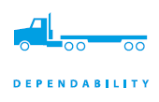
Eight Great Ideas
Design for Moore’s Law
Use abstraction to simplify design
Make the common case fast
Performance via parallelism
Performance via pipelining
Performance via prediction
Hierarchy of memories
Dependability via redundancy

Slide 17
QUESTIONS!!!

